Slide 1
Defense for Securing Wireless Networks

Slide 2
Theory of Defense for Securing Wireless Networks
You should now have a thorough understanding of some of the many attack vectors available to target wireless networks and clients.
In this chapter, we’re going to cover the concepts that will form the basis for securing your wireless networks.
Then we’ll take the concepts you learn in this chapter to design secure wireless networks to accomplish common goals.

Slide 3
Phases of Wireless Deployment
New deployments
Existing wireless networks
Wireless refresh projects

Slide 4
New Deployments
When deploying a new wireless network, you are in a unique position to do things correctly from the start.
Whether you’re tasked with designing the installation, deploying the wireless network, managing and maintaining the installation, or securing it, you need to voice your concerns from the beginning.
During the initial pre deployment discussions, it is imperative to decide if a wireless network is in fact the best solution for your organization, and security should be at the forefront of this discussion.

Slide 5
Existing Wireless Networks
Many existing wireless networks out there need to be secured.
Maybe you’ve just joined a new organization and have been handed the joyful task of assessing the current wireless network and providing recommendations for securing it.
Maybe you’ve managed the wireless network since its inception and are now aware of security vulnerabilities that need to be mitigated.
Therefore, it is your job to show them the severity of not securing their wireless network.

Slide 6
Wireless Refresh
A project to refresh your existing wireless network or a gut-and-replace project to upgrade your wireless infrastructure.
Even just upgrading select components of your wireless infrastructure, is a perfect opportunity to include security measures where they didn’t exist before.
You should treat any of these opportunities the same as a pre-deployment project and integrate security from the beginning.

Slide 7
Secure Design Principles for Wireless Networks
The following secure design principles are as follows:-
Defense In Depth
Least Privilege
Network segmentation
Wireless assessments
Secure the infrastructure itself
Rogue AP detection
Physical security
Change default configurations
Due diligence
CIA

Slide 8
Secure Design Principles for Wireless Networks
Defense In Depth:- Using multiple defense mechanisms where possible.
Least Privilege:-Allowing only what is necessary for users and systems.
Network segmentation:- Restricting access between network hosts.
Wireless assessments:-Assessing the security of your wireless network.
Securing the infrastructure itself :-On all components of your wireless network, including the access points.

Slide 9
Rogue AP detection:-Detecting unauthorized wireless access points.
Physical security:-Restricting physical access to infrastructure, including wireless access points
Changing the default configurations:- On all systems, including wireless access points.
Due diligence:- Staying proactive to secure your wireless network.
CIA:- Confidentiality Integrity Availability.

Slide 10
Confidentiality:-
Confidentiality is roughly equivalent to privacy. Confidentiality measures are designed to prevent sensitive information from unauthorized access attempts.
Confidential information often has value and systems are therefore under frequent attack as criminals hunt for vulnerabilities to exploit.
Example:-
Medical information.
Names, dates of birth, addresses, contact details (of staff, clients, patients, pupils, etcetera).
Personal bank details and credit card information.

Slide 11
Integrity:-
Integrity measures protect information from unauthorized alteration.
These measures provide assurance in the accuracy and completeness of data.
The need to protect information includes both data that is stored on systems and data that is transmitted between systems such as email.
Availability:-
In order for an information system to be useful it must be available to authorized users.
Availability measures protect timely and uninterrupted access to the system.
Some of the most fundamental threats to availability are non-malicious in nature and include hardware failures, unscheduled software downtime and network bandwidth issues.

Slide 12
Useless defense
Faraday cage
MAC filtering

Slide 13
Faraday Cage
Faraday Cage At the most basic level, you can think of a Faraday cage as a system for confining the physical propagation of wireless signals.
In the real world, typically this is accomplished by putting up wireless mesh around a building or area so that wireless signals from the outside can’t get in and wireless signals from the inside can’t get out.
High gain antennas can be used to pick up very weak wireless signals.
Also, the use of signal limiting systems seems to give people a false sense of security.

Slide 14
MAC Filtering
MAC address filtering enables an administrator to define specific hosts that are allowed to associate with the wireless network.
The hosts are defined by the MAC address of their wireless card. MAC filtering is the perfect example of a whitelist.
Remember that a MAC address is the hardcoded address that identifies your specific network card.
MAC filtering might conceptually make sense, but in practice it affords no real security.

Slide 15
Good Wireless Defenses
Firewalls
Routers
Switches
Intrusion detection systems and intrusion prevention systems
Honeypots

Slide 16
Firewall
What is firewall ?
A Firewall is a network security device that monitors and filters incoming and outgoing network traffic based on an organization's previously established security policies.
At its most basic, a firewall is essentially the barrier that sits between a private internal network and the public Internet.
Firewall itself can be hardware or software, it can also consist of a combination of both.

Slide 17
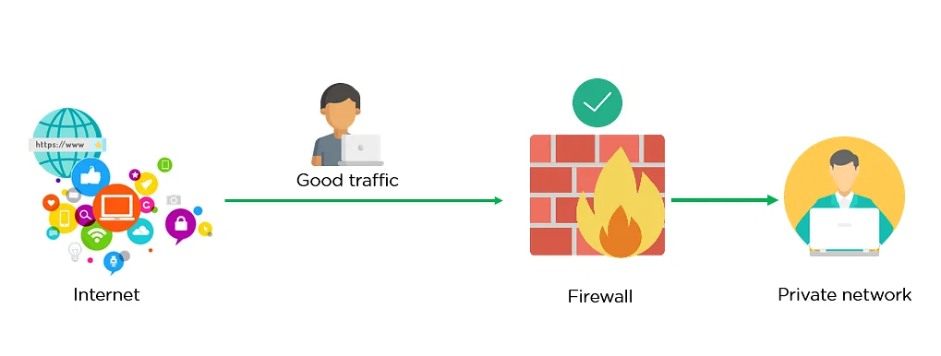
Firewall allowing Good Traffic

Slide 18
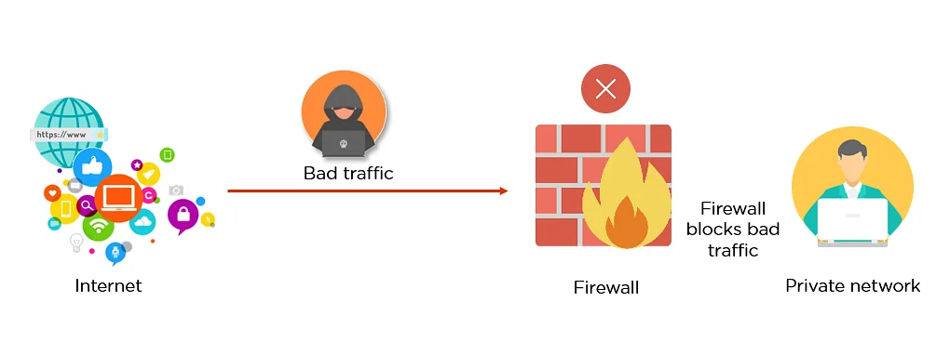
Firewall blocking Bad Traffic

Slide 19
Advantages of Using Firewalls
It provides enhanced security and privacy from vulnerable services.
It prevents unauthorized users from accessing a private network that is connected to the internet.
Firewalls provide faster response time and can handle more traffic loads.
A firewall allows you to easily handle and update the security protocols from a single authorized device.
It safeguards your network from phishing attacks.

Slide 20
Routers
A router works on the 3rd layer (Network Layer) of the OSI model.
Router acts as a core device that set up the network in a Local Area and manages the communication of all the devices which are connected to it.
The router forwards or delivers the data packets in an organized way between computer networks.
It forwards the IP between the wireless subnet and other subnets.
It can connect both end-user clients and acts as a gateway between the LAN and the internet.
A Router is a combination of an Access Point (AP), an Ethernet Router and a Firewall. It can serve both wired and wireless connectivity to the end-users.

Slide 21
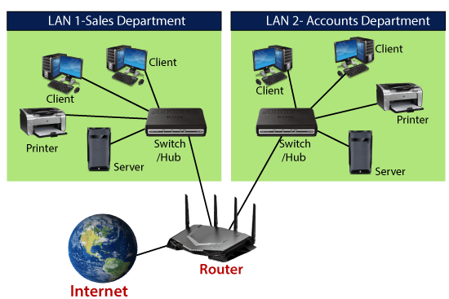
Routers

Slide 22
Features of Router
A router works on the 3rd layer (Network Layer) of the OSI model.
It is able to communicate with its adjacent devices with the help of IP addresses and subnet.
A router provides high-speed internet connectivity with the different types of ports like gigabit, fast-Ethernet, and STM link port.(Synchronous Transport Module)
It allows the users to configure the port as per their requirements in the network.
It allows the users to connect several LAN and WAN.
Furthermore, a router creates various paths to forward the data.

Slide 23
Switch
Switches are networking devices operating at layer 2 or a data link layer of the OSI model.
They connect devices in a network and use packet switching to send, receive or forward data packets or data frames over the network.
A switch has many ports, to which computers are plugged in.
When a data frame arrives at any port of a network switch, it examines the destination address, performs necessary checks and sends the frame to the corresponding device(s).
It supports unicast, multicast as well as broadcast communications.

Slide 24
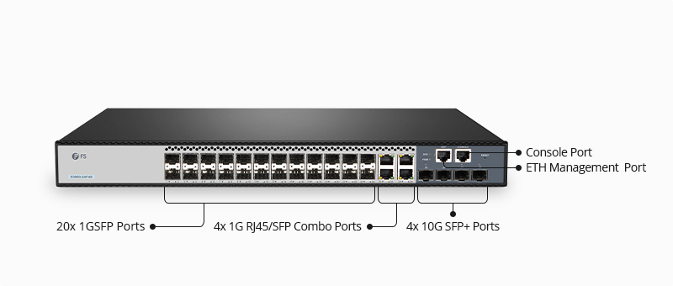

Slide 25


Intrusion detection system (IDS)
It will just detect the virus and alarm you. Ex.
Intrusion prevention system (IPS)
It will prevent it and update you. Ex.
Pomeranian dog
German shepherd

Slide 26
IPS | IDS
IPS is a control system that accepts and rejects a packet based on the ruleset. | IDS is a detection and monitoring tool which do not take action on their own.
IPS requires that the database to regularly updated with new threat data. | IDS requires human or another system to examine results.
It should be placed after the firewall device in a network. | IDS should be placed after the firewall.
The IPS is active software. | The IDS is a passive type of software.
Slow down network performance due to delay caused by inline IPS processing | Does not impact network performance due to non-line deployment of IDS.

Slide 27
Honeypot
A honeypot is a security mechanism that creates a virtual trap to lure attackers.
An intentionally compromised computer system allows attackers to exploit vulnerabilities so you can study them to improve your security policies.
You can apply a honeypot to any computing resource from software and networks to file servers and routers.
Honeypots are a type of deception technology that allows you to understand attacker behavior patterns.
Security teams can use honeypots to investigate cybersecurity breaches to collect intel on how cybercriminals operate.
They also reduce the risk of false positives, when compared to traditional cybersecurity measures, because they are unlikely to attract legitimate activity.

Slide 28
